Slide 1
Climate Change Forecast
Holistic study of change in Global Land temperature and Associated factors
Team 4: Biheng, Chandrashila, Divya, Disha, Chakradhar

Slide 2
Agenda
Background
Problem statement
Data preprocessing
Models
Forecasting and Conclusion

Slide 3


Background
Daily life
Extreme weather

Slide 4
Problem Statement
Global warming?
Exogenous factors

Slide 5
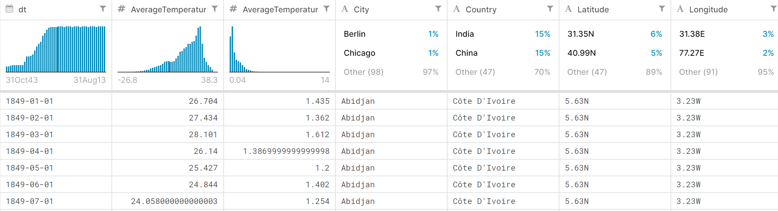
A brief look at the dataset

Slide 6
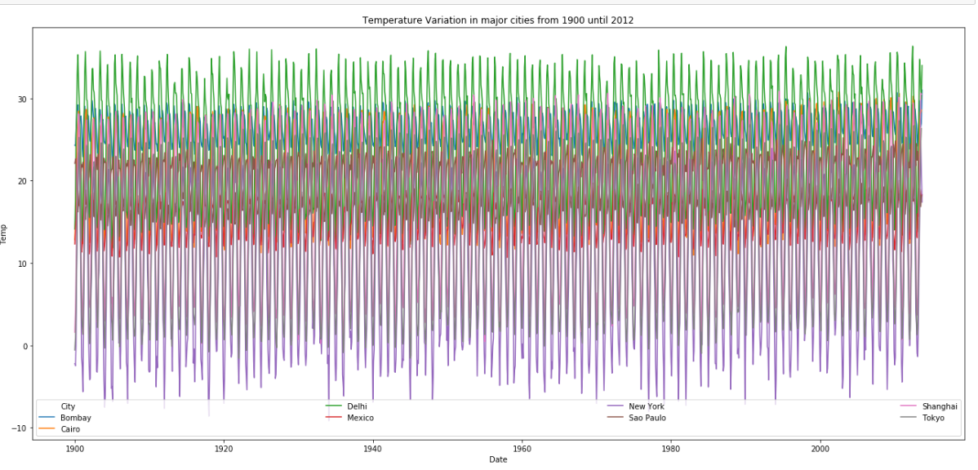
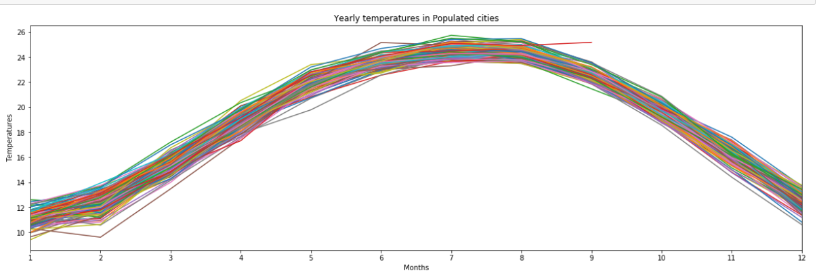
Data Preprocessing
Importing required libraries in Python notebook
Data cleaning
Data exploration

Slide 7
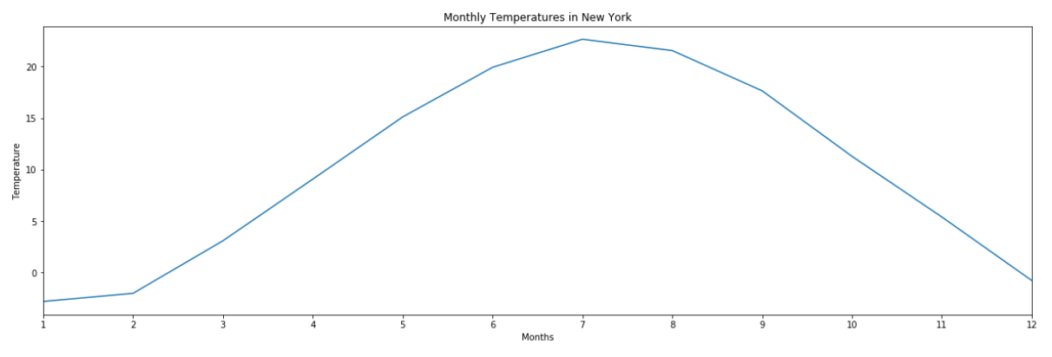
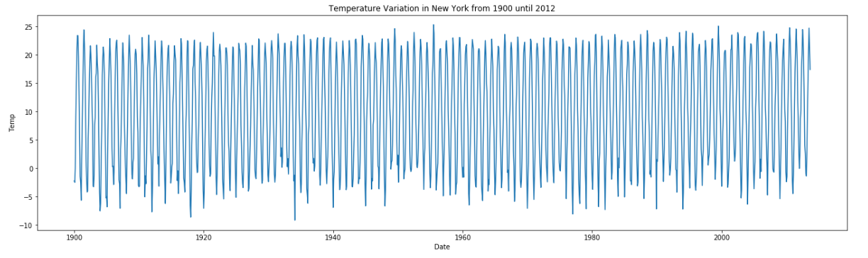
Seasonality

Slide 8
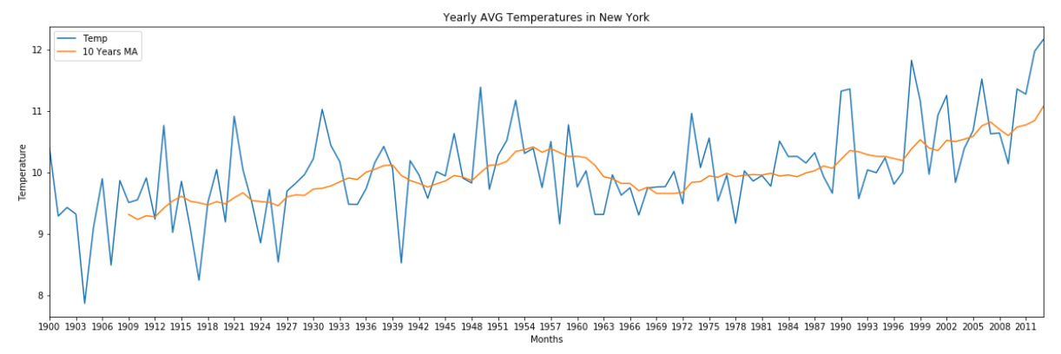
Trend
Increasing trend
50% increase over 100 years
8- 12 degree.

Slide 9
Time Series Analysis
Data Splitting:
Training set- from year 1900 – September 2008
Validation set– October 2008 - September 2012
Testing set– October 2012 – September 2013

Slide 10
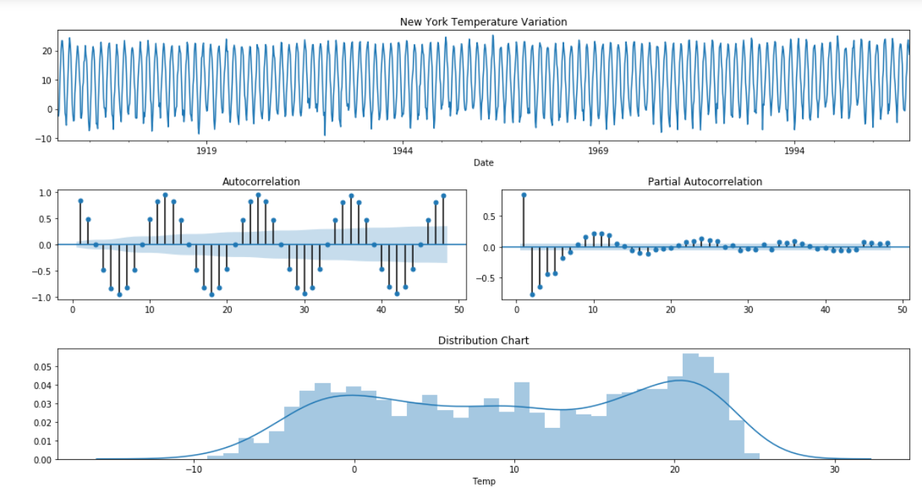
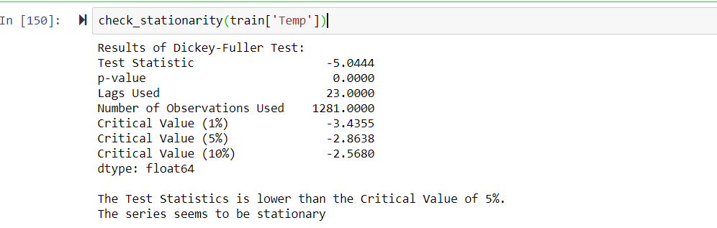
Stationery Test
. Augmented Dickey-Fuller test to check trend and seasonality in the original series
ACF and PACF plots suggests an AR(1) model and also a first seasonal difference (Y(t)-Y(t-12))

Slide 11
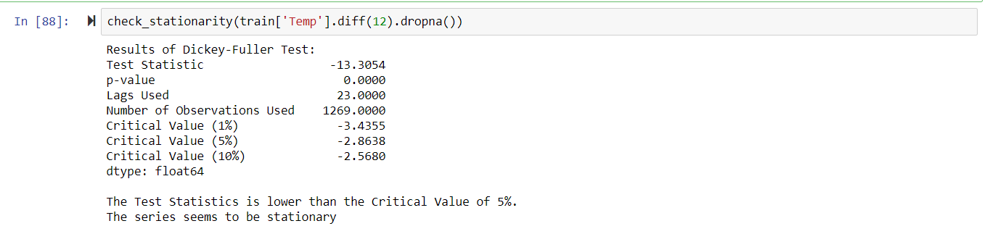
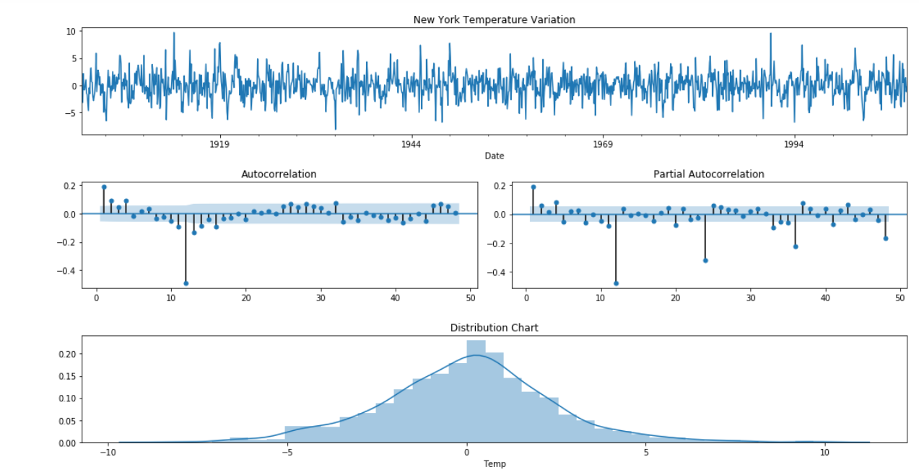

Slide 12
White Noise Test
Ljung-Box test to check white noise in the original series and residual analysis

Slide 13


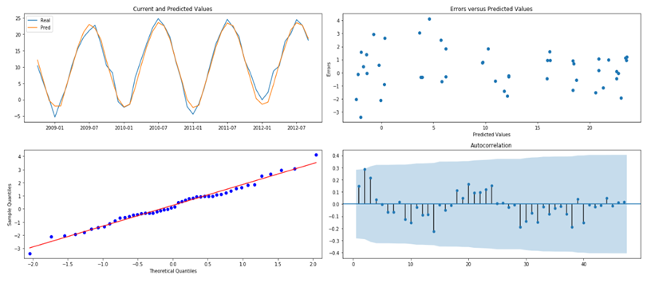
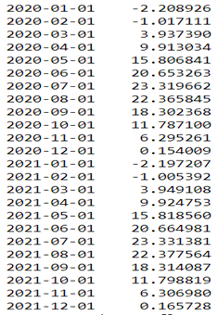
SARIMA – Models on cities
Model 1 Seasonal ARIMA
Notes:
Model 1: ARIMA(1, 1, 1)x(0, 1, 1, 12)12 - AIC:4933.10428 is the best
The RMSE of the SARIMA(1,1,1),(0,1,1,12),'c' model is 1.5125 Celsius degrees It's a decrease of -69.18% in the baseline RMSE
#Analyzing the plots above we can see that the predictions fit very well on the current values.
1.The Error vs Predicted values has a linear distribution.
2.The QQ Plot shows a normal pattern with some little outliers and,
3.The autocorrelation plot shows no significant lags (outside 95% Confidence Interval).
#White noise test on residuals
sm.stats.acorr_ljungbox(val['Error'], lags=[12],boxpierce=True) :- output : (array([11.52010506]), array([0.48494784]), array([10.03827422]), array([0.61260276]))
#the 2nd list in the returned array is p-values from the ljungbox test and the 4th list is the p-values from the boxpierce test.
#Since p-value > .05,both tests agree that residuals(each of it's first 12 lags with > 95% confidence level) are white noise .

Slide 14

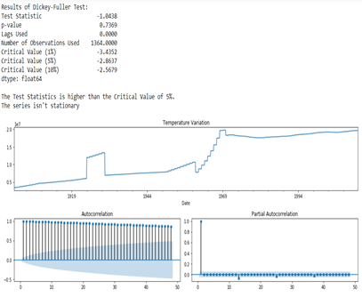
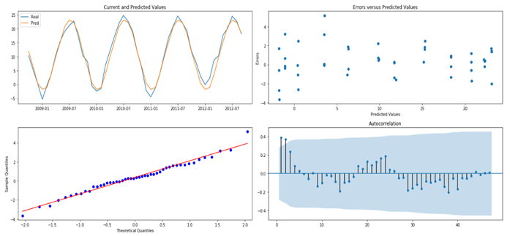
SARIMA – Population Regressor Model
Model 2 Seasonal ARIMA with exogenous: ‘Population’
Notes:
Model 2 : Seasonal ARIMA with Population as a regressor
SARIMAX(1, 0, 1)x(0, 1, [1, 2], 12) with AIC: 5250.547
But coefficient of population is very less than 0.05 so this regressor has very little contribution in the model’s prediction. This is might be because the Population data is yearly however rest of the data i.e. temperature variable is monthly.
The RMSE of the SARIMAX with exogenous model is 1.6883 Celsius degrees It's a decrease of -65.6% in the RMSE
#Analyzing the plots above we can see that the predictions fit very well on the current values.
The Error vs Predicted values has a linear distribution.
The QQ Plot shows a normal pattern with some little outliers and,
But the autocorrelation plot shows lag=1 and lag=2 as significant (outside 95% Confidence Interval).
#Hence, the model after adding population parameter is less superior than the model without exogenous variable.
#white noise test on residuals
sm.stats.acorr_ljungbox(valpop['Error'], lags=[12],boxpierce=True)
#the 2nd list in the returned array is p-values from the ljungbox test and the 4th list is the p-values from the boxpierce test.
#Since p-value < .05,both tests agree that residuals(each of it's first 12 lags with > 95% confidence level) are not quite white noise.
#Hence, model can be improved.

Slide 15
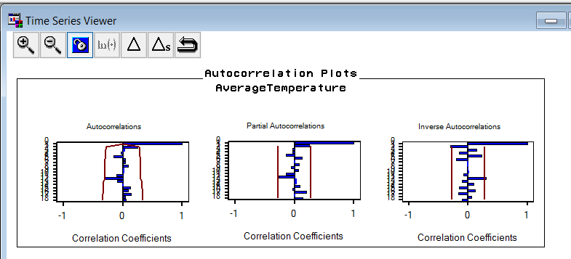
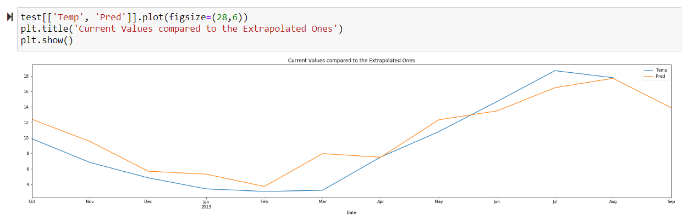
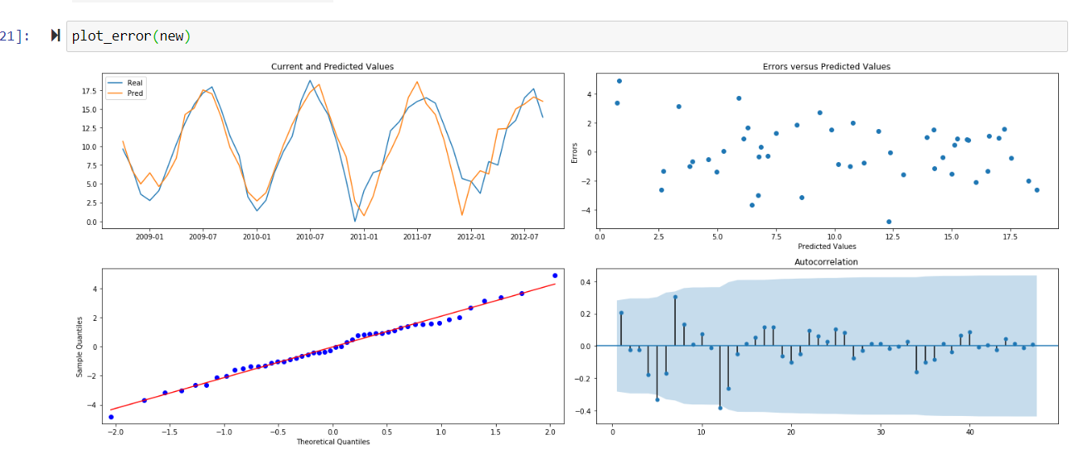
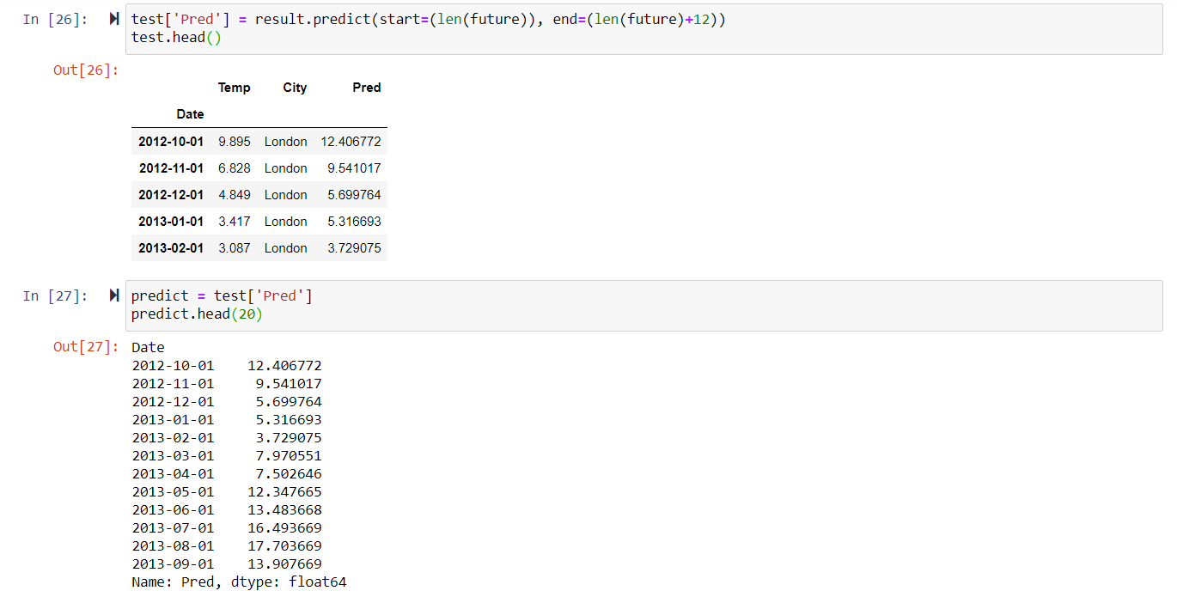
SARIMA – Models on countries
The RMSE for SARIMA Model is 1.84 celsius degree
Residual Analysis
Best model : ARIMA(1,0,1)(1,1,1)S with least AIC 11790.83
Predictions

Slide 16
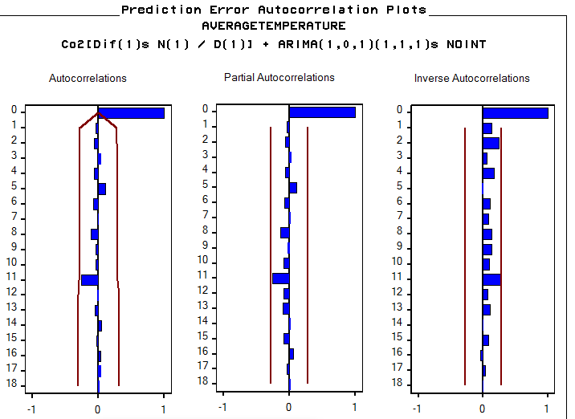
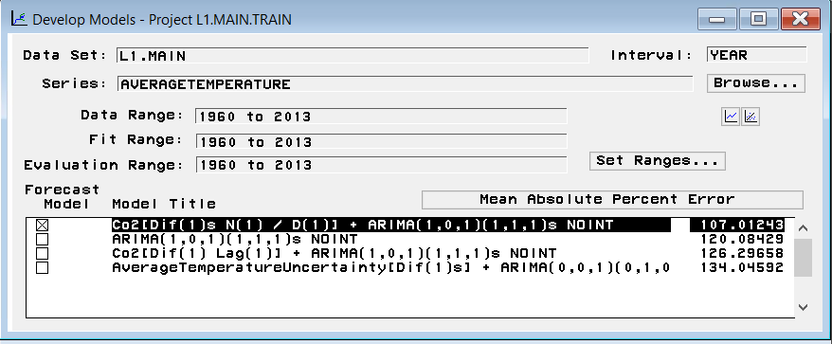
SARIMA – CO2 Regressor Model
Model 3: Added Co2 emission and Average Temperature uncertainty as a dynamic regressor on SARIMA model
MAPE=107.01

Slide 17
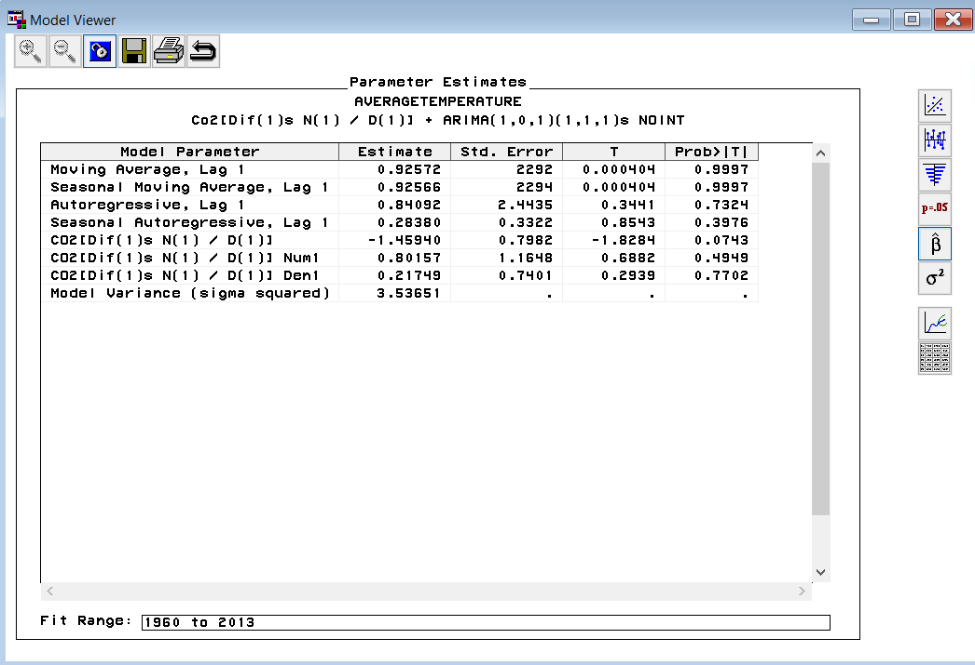
REGRESSOR-ANALYSIS 1.CO2 emission 2.Average Temperature uncertainty
Calculated MAPE
DT | ACTUAL | Predicted value | ABS
1/1/1998 | 4.978 | 3.2174 | 35.36762
1/1/1999 | 5.565 | 3.8705 | 30.44924
1/1/2000 | 4.693 | 3.8454 | 18.06094
1/1/2001 | 3.149 | 3.6464 | 15.79549
1/1/2002 | 5.618 | 3.8652 | 31.19972
1/1/2003 | 4.049 | 4.1218 | 1.797975
1/1/2004 | 4.889 | 3.651 | 25.32215
1/1/2005 | 5.707 | 3.9965 | 29.97196
1/1/2006 | 4.04 | 4.3049 | 6.556931
1/1/2007 | 6.896 | 4.2151 | 38.87616
1/1/2008 | 6.721 | 5.033 | 25.11531
1/1/2009 | 2.769 | 5.8907 | 112.7375
1/1/2010 | 1.381 | 3.6594 | 164.9819
1/1/2011 | 4.1 | 4.0083 | 2.236585
1/1/2012 | 5.313 | 4.06 | 23.58366
1/1/2013 | 3.417 | 4.2956 | 25.71261
 |  | MAPE | 36.73536

Slide 18
Data Mining Results and Forecasting

Slide 19
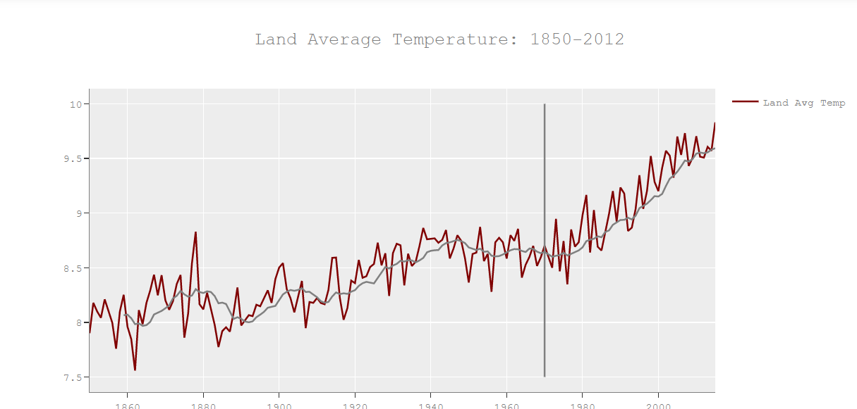
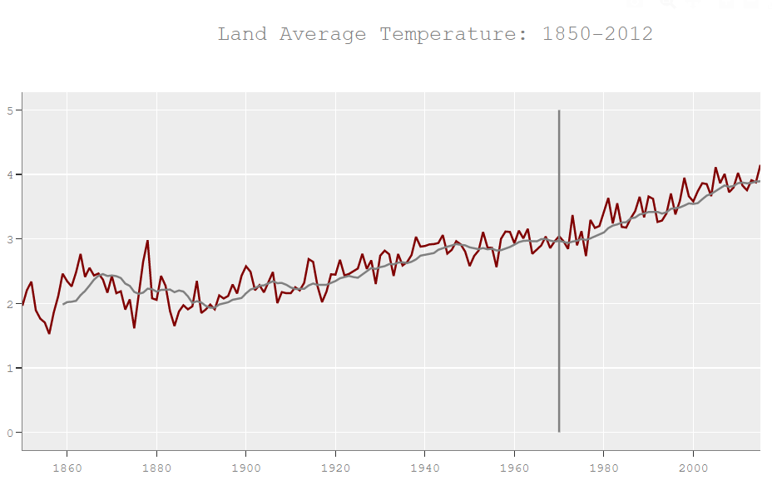
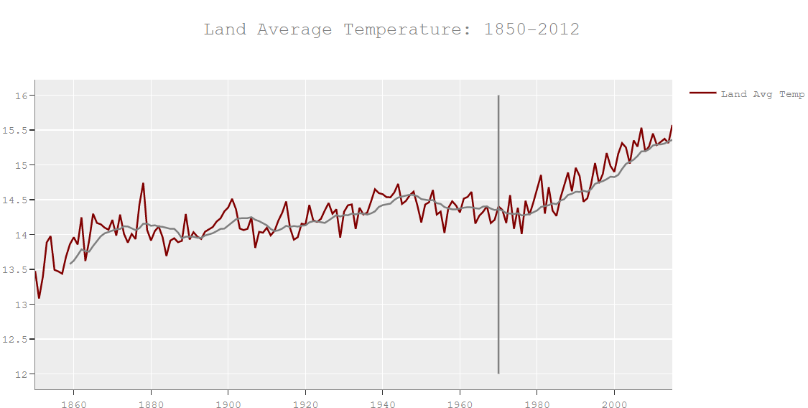
Exploration Results

Slide 20
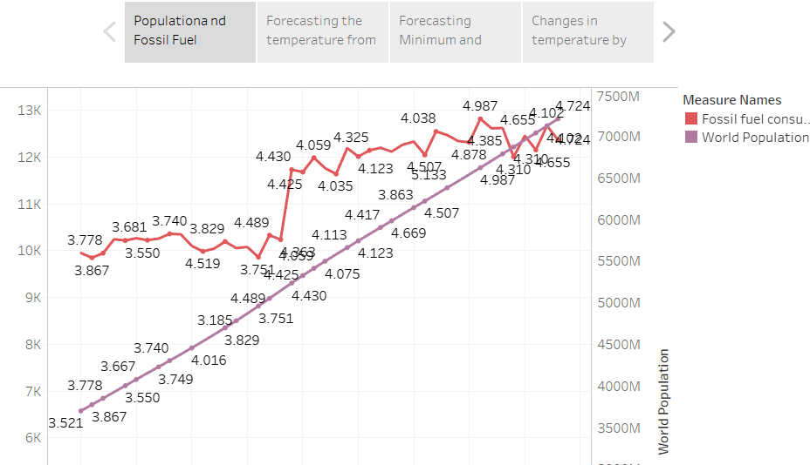
Variation of Temperature with Fossil Fuel Consumption and Population Growth

Slide 21
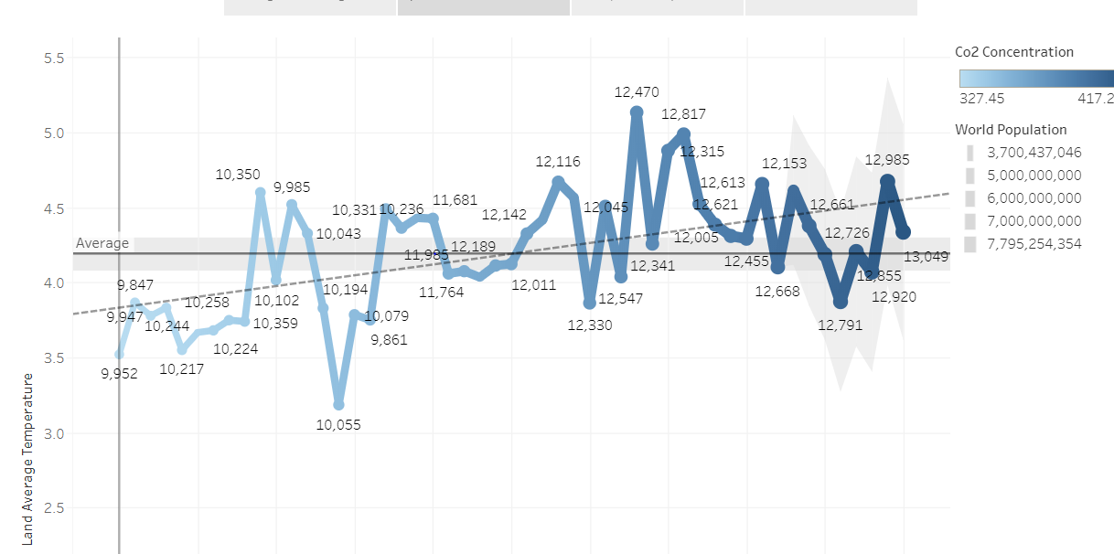
Forecasting Exponential Smoothing

Slide 22
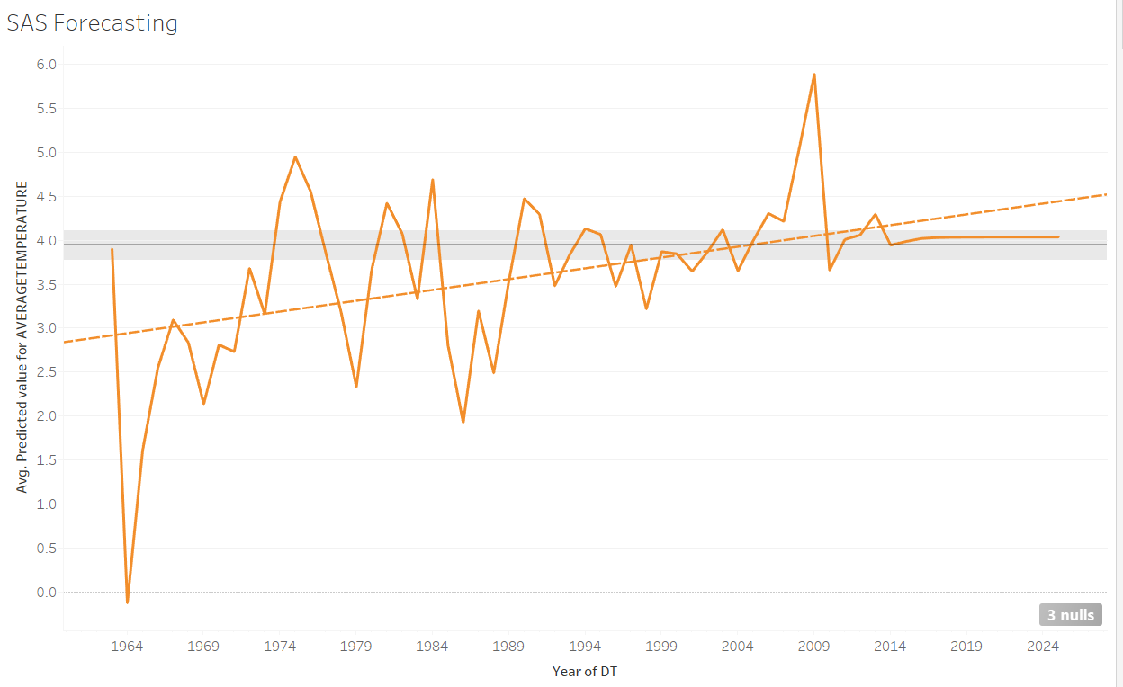
Forecasting From SAS

Slide 23
Conclusion
Global Average Temperatures- The global Average Temperature is forecasted with upper limit of 0.8 degree.
New York City Temperature- The New York Average temperature is predicted for 2021 with RMSE value of
Predicting weather is easier but predicting the temperature after 20 years or change in temperature after 20 years constitutes of different regressors that will influence it mainly.

